Slide 1

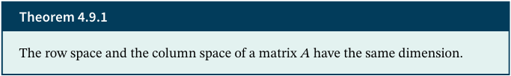

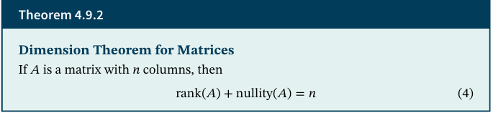
If 𝐴 is an m×n matrix, then
rank(A)=the number of leading variables or pivots
nullity(𝐴)=the number of parameters

Slide 2
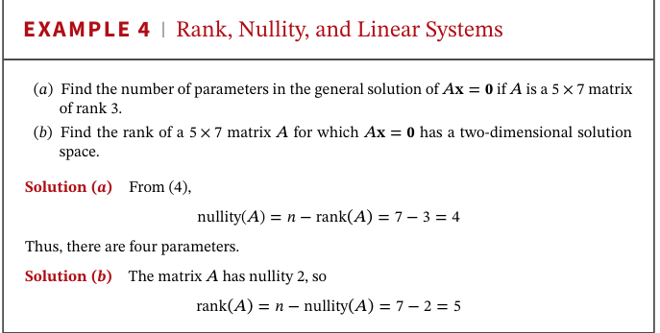

Slide 3


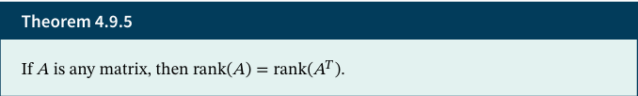
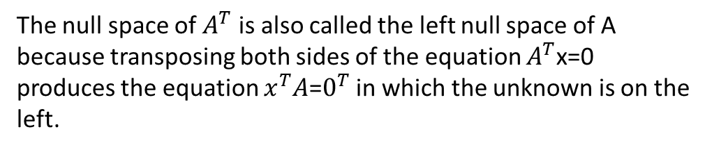
The null space of $A^{T}$ is also called the left null space of A because transposing both sides of the equation $A^{T}$x=0 produces the equation $x^{T}$𝐴=$0^{T}$ in which the unknown is on the left.

Slide 4
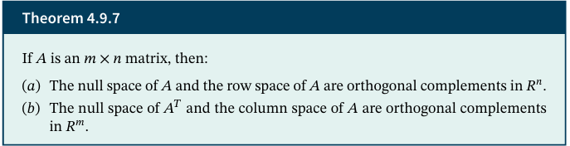
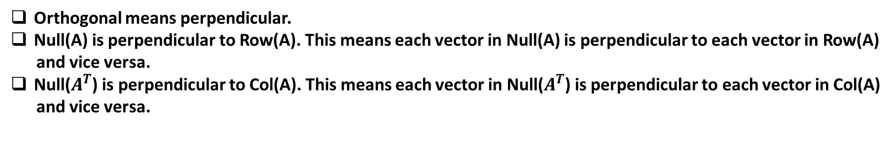
Orthogonal means perpendicular.
Null(A) is perpendicular to Row(A). This means each vector in Null(A) is perpendicular to each vector in Row(A)
and vice versa.
Null($A^{T}$) is perpendicular to Col(A). This means each vector in Null($A^{T}$) is perpendicular to each vector in Col(A)
and vice versa.

Slide 5
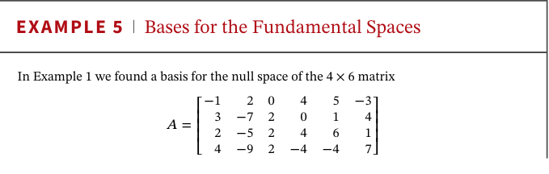
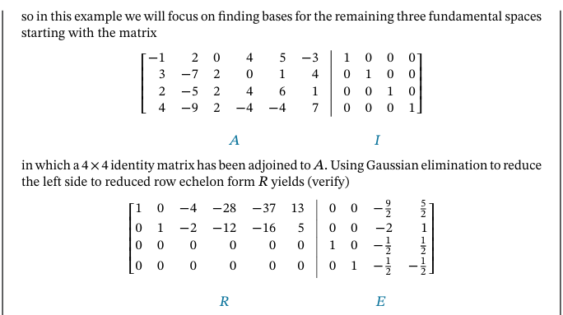

Slide 6
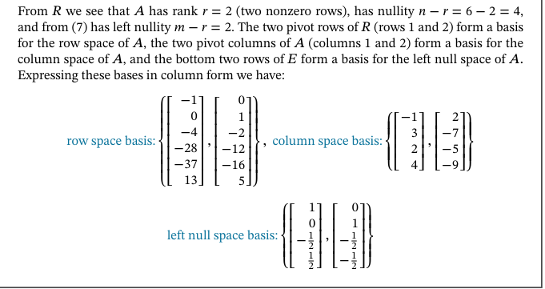

Slide 7
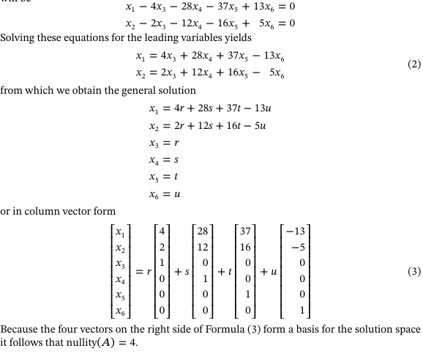
Basis for Null(A):
Solving Ax=0

